Slide 1
Exposure assessment after wildfire incidents
LCDR Catherine C Beaucham, PhD, CIH, REHS
May 2024

Slide 2
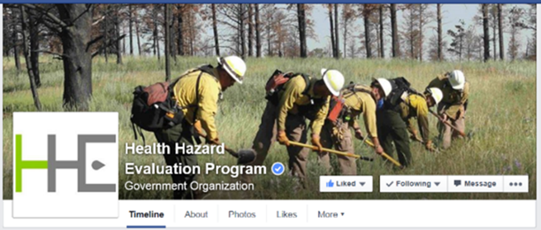
NIOSH Health Hazard Evaluation (HHE) Program
Worksite evaluation to determine whether harmful exposures, processes, or conditions pose a hazard to workers
Respond to requests from employees; employers; unions; and federal, state, or local government agencies
Provide facility-specific recommendations to control identified hazards
Free
Photo by NIOSH.
Notes:
Describe what NIOSH is before this.

Slide 3
Some of the many materials released during fires
CHEMICAL CLASS | POTENTIAL HEALTH EFFECTS
Polycyclic aromatic hydrocarbons (PAHs) | Carcinogenic (benzo[a]pyrene), Cyclopenta(c,d)pyrene, dibenz(a,h)anthracene, dibenzo(a,l)pyrene
Volatile organic compounds (VOCs) | Carcinogenic (benzene, 1,3-butadiene, vinyl chloride) Styrene. Also has central nervous system effects
Aldehydes | Carcinogenic (formaldehyde), respiratory sensitizer (formaldehyde), pulmonary edema (acrolein)
Acid gases | Respiratory irritation, pulmonary edema, chemical asphyxiation (HCN)
Phthalates/plasticizers | Endocrine disruption, liver tumors in animals (DEHP)
Flame retardants and other Persistent Organic Pollutants | Accumulates in the body, thyroid, liver, immune system effects, neurodevelopmental effects (PBDEs and OPEs), liver tumors in animals (deca-BDE)
Dioxins and furans | Accumulates in the body, similar health effects as PBDEs, carcinogenic (TDCPP)
Per- and polyfluoroalkyl substances (PFAS) | Endocrine disruption, immunotoxicity, carcinogenic, thyroid effects Perfluorooctanoic acid (currently under revision)
Diesel exhaust | Carcinogenic
May be produced when organic materials are burned
May be produced when synthetic materials are burned
Source: Austin 2010 Firefighting Exposure Data http://monographs.iarc.fr/ENG/Monographs/vol98/index.php
HCN = hydrogen cyanide; DEHP = bis(2-ethylhexyl)phthalate; TDCPP = tris(1,3-dichloro-2-propyl)phosphate; PBDE = Polybrominated diphenyl ethers; OPE = Organophosphate Esters
Notes:
Fires are full of contaminants, especially with the newer residential structures containing more plastics and flame retardants. Products of combustion primarily contain things like Polycyclic Aromatic Hydrocarbons (PAHs), and Volatile Organic Compounds (VOCs), many of which are known carcinogens or probable human carcinogens.
PAHs have been measured in several firefighter exposure studies (produced during fire, air, dermal, and biological sampling methods exist)
Note that burning synthetic materials will also produce PAHs, VOCs, aldehydes. Diesel exhaust is its own category really.

Slide 4
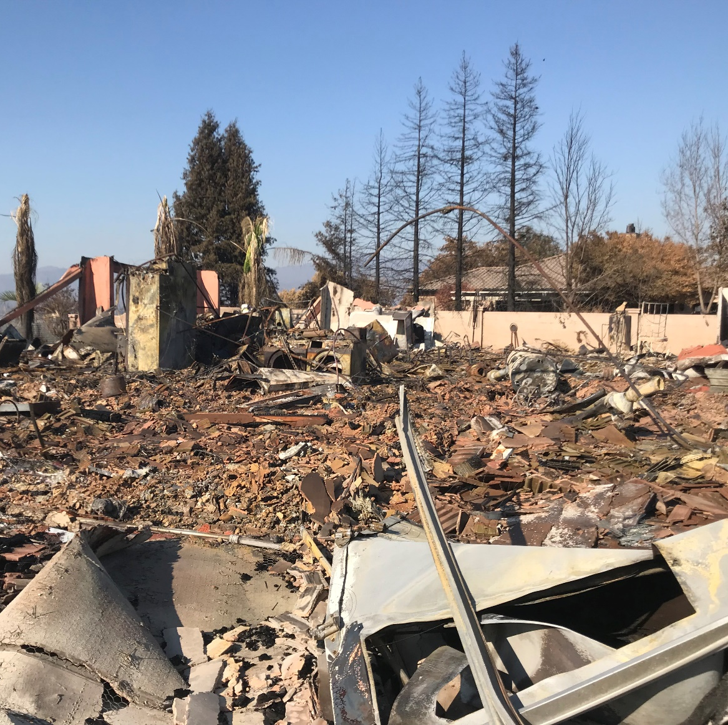

Other materials released during fires
Heavy metals
Known Carcinogen: Cadmium
Probable Carcinogen: Lead
Minerals / fibers
Known Carcinogen: Silica and asbestos
Other flame retardants (brominated, chlorinated, and phosphorylated)
Probable Carcinogen: Tetrabromobisphenol A
Notes:
Other materials include Heavy Metals (Lead, Cadmium, Nickel, Mercury, Arsenic, and many many more.... Especially during urban/rural interface fires.
Urban/Rural are especially challenging due to the way that Wildland Firefighters work which is often without respiratory protection.

Slide 5
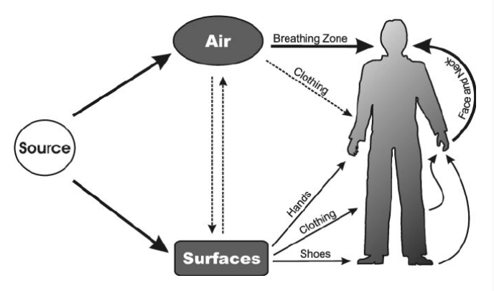
Over 1.1 million firefighters protect our communities & environment
~1.4 million fires in the U.S. every year
~500 thousand structure fires
~1-5% of a firefighter’s time spent at structure fires (20-100 hrs/yr)
Wildfire season growing in length & severity
Hazardous exposures
Hundreds of combustion byproducts
Dozens are recognized carcinogens
PFAS, flame retardants, shift work
NPFA - http://www.nfpa.org/research/reports-and-statistics/fires-in-the-us; Kales et al. 2007; Guidotti 2014 AOHC ; IARC Monographs (2020)
Notes:
In the U.S, there are over 1.1 million firefighters that protect our homes, communities, and environments.
Every year these FFs respond to roughly 1.4 million fires, a half a million of which are burning structures.
Exposure studies have shown that there are hundreds of compounds released from burning materials. Over a dozen known carcinogens have been identified on the fireground; and even more probable and possible carcinogens have been measured as well.
This is an exposure pathway diagram and illustrates just how complicated the exposure process can be. It’s not just what firefighters may inhale during a response, but also what may contaminate their PPE and equipment, transfer to their skin, off-gas from their gear, and so on.

Slide 6
Wildfires
Biomonitoring of Wildfire Responders
National trend in wildfire since 1998 show that each wildfire is burning more land.
In 2017 alone, over 10 million acres of land were ravaged by wildfires.
When wildfires extend into residential areas remnants of burned structures may contain many contaminants in the smoke and ash left behind
Wildland firefighters and debris cleanup crews may be exposed to those contaminants.
Resources:
NIFC [2017]. National report of wildland fires and acres burned by state 2017. Boise, ID: National Interagency Fire Center, https://www.predictiveservices.nifc.gov/intelligence/2017_statssumm/fires_acres17.pdf. NIFC [2018]. National report of wildland fires and acres burned by state 2018. Boise, ID: National Interagency Fire Center, https://www.predictiveservices.nifc.gov/intelligence/2018_statssumm/fires_acres18.pdf.
National Academy of Sciences, 2021: https://www.pnas.org/doi/10.1073/pnas.2011048118

Slide 7
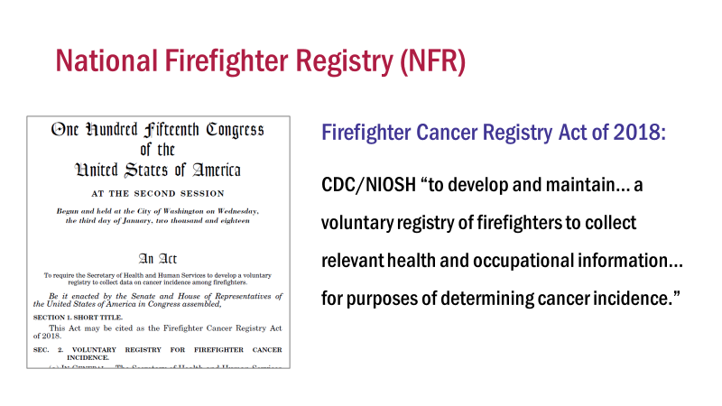

Slide 8
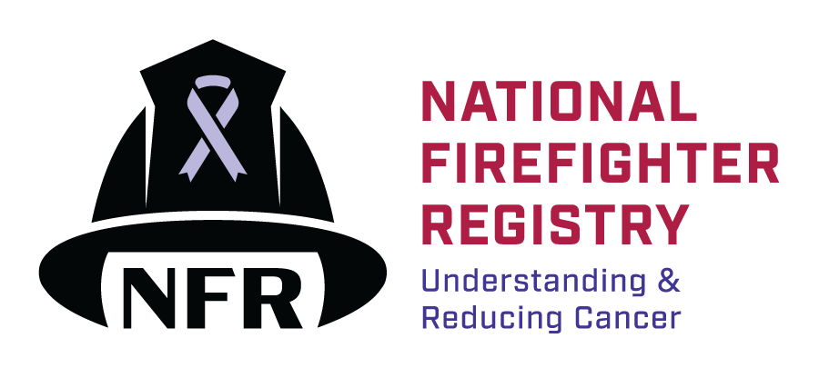
National Firefighter Registry (NFR)
Mission: To generate detailed knowledge about cancer in the fire service through a voluntary registry that reflects our nation’s diverse firefighters.
Vision: To equip the fire service and public health communities with the knowledge they need to reduce cancer in firefighters.
Components:
Collect self-reported information on workplace & personal characteristics through online portal
Obtain records from fire departments or agencies to track trends and patterns of exposure
Link with health information databases including population-based cancer registries and the National Death Index to detect cancers and deaths
Make de-identified data available for external researchers
Notes:
The goal of this National Firefighter Registry is to track cancer & risk factors over time to better understand the link between workplace exposures and cancer.
Our Mission is to…
And our Vision is to…
Lastly, with input and guidance from our NFR Subcommittee (a Federal advisory committee consisting of fire service, medical, and scientific professionals), we established several primary components of the NFR. #1…

Slide 9
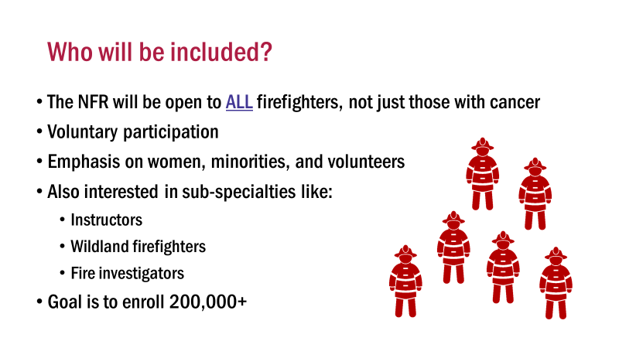

Slide 10
Biomarkers of Exposure
Matrix | Chemical Group | Analyte
Blood | Persistent organic pollutants (POPs) | Per and Polyfluoroalkyl substances (PFAS)
 |  | Polybrominated diphenyl ethers (PBDEs)
 | Halogenated organic compounds | Dioxins, PCBs, etc.
 | Metals | Cadmium, Lead, Manganese, Selenium, Lithium
Urine | Organophosphate esters (OPEs) | Diphenyl phosphate and others
 | Polycyclic aromatic hydrocarbons (PAHs) | Naphthalene, fluorene, phenanthrene, etc
 | Volatile Organic Compounds | Benzene, toluene, ethylbenzene, xylene, styrene, etc
 | Other | Phthalates, phenols, pesticides, herbicides, etc.
 | Metals | Chromium, Arsenic, Nickel, Mercury
Notes:
Other products of combustion:
(Blood) Dioxins
(Urine) Polycyclic aromatic hydrocarbons: PAHs are formed during the pyrolysis and incomplete combustion of organic matter and originated from different natural sources such as fires and volcanic eruptions and anthropogenic sources including burning of wood, agricultural residues, and fossil fuels such as petroleum, coal tar, and gas as well as industrial and traffic emissions sources
(Urine) VOCs –benzene, toluene, ethylbenzene, xylene, styrene, and decane: Firefighters may be exposed to BTEX during the burning of VOCs-containing materials, principally during structure fires such as residential, industrial or oil wells facilities training exercises and prescribed forest fires, which frequently use diesel fuel, heating oil, plywood, pallet, straw, firewood, and particle chipboard as fuels
(Urine/Blood) Other metals:
-Lithium
-Mercury
(Urine) Unmetabolized phthalates, phenols, pyrethroid pesticides and several herbicides from the chlorophenoxyacetic acids family and metabolized organophosphorus insecticides, and dioxins pollutants were characterized in the urine of firefighters

Slide 11
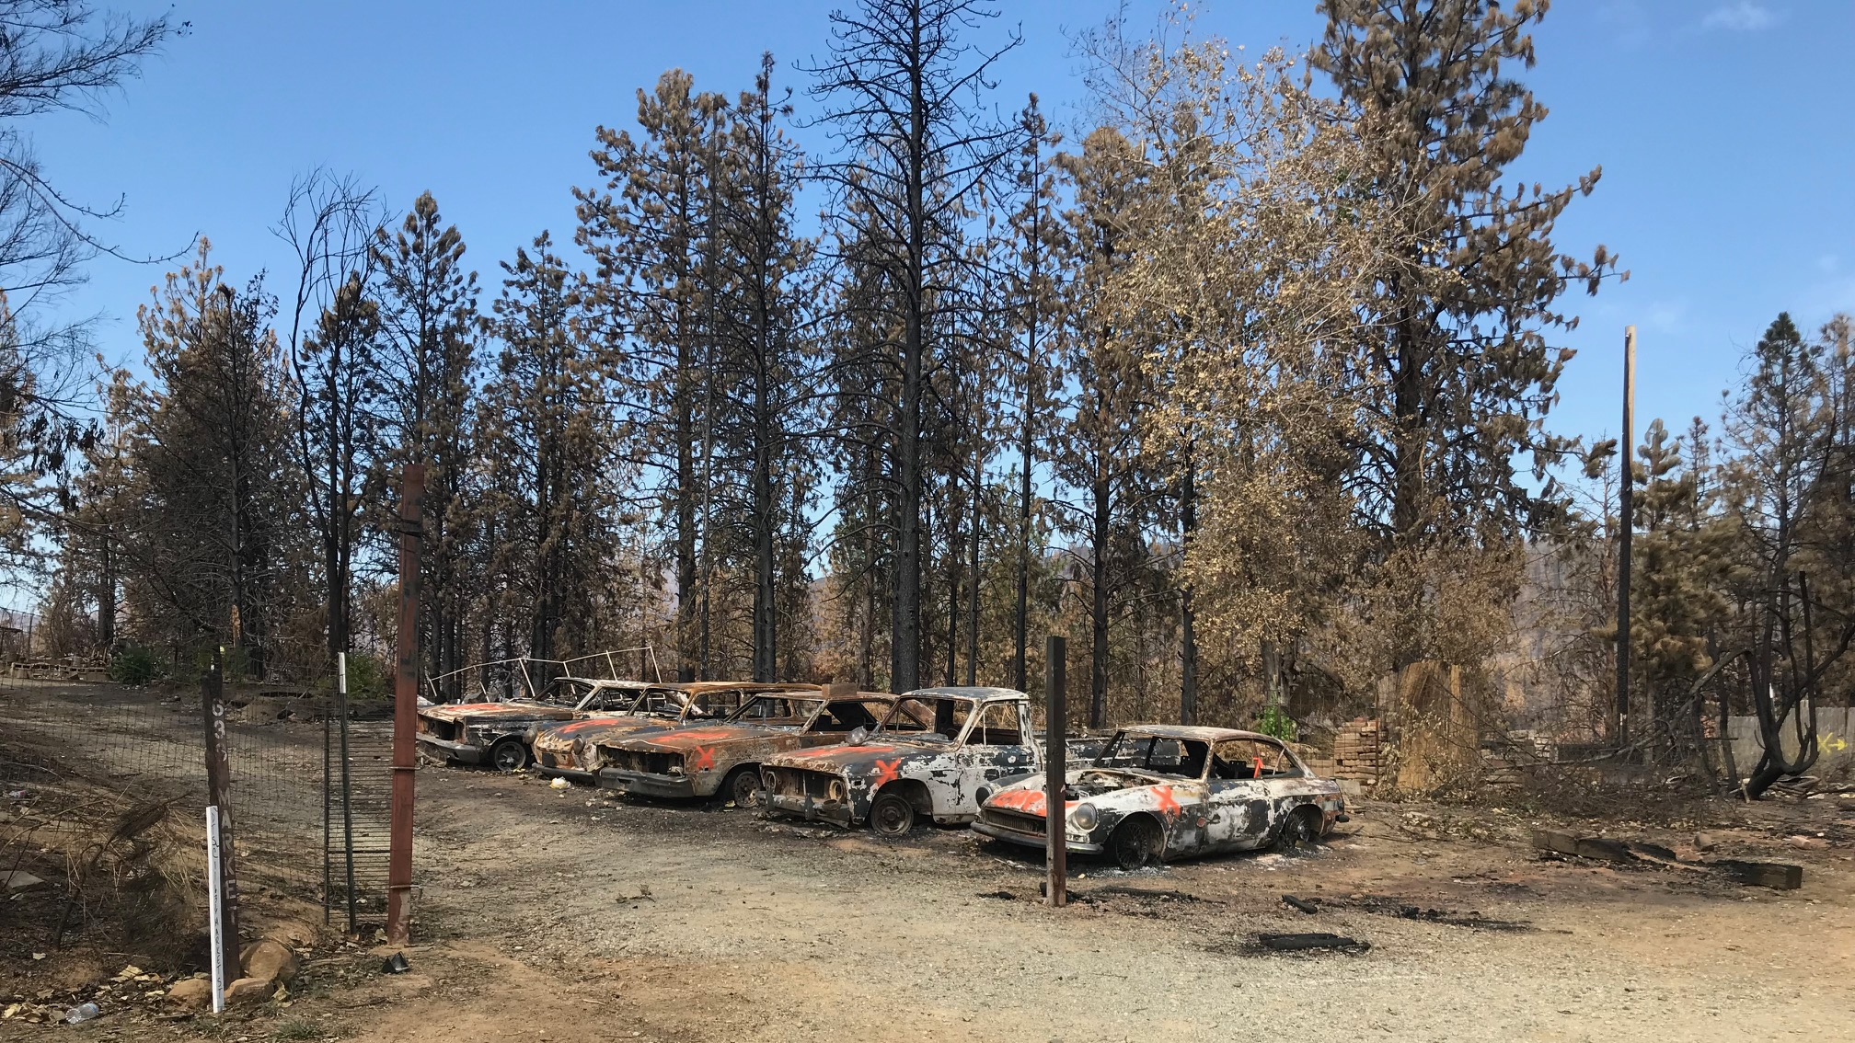
Fire debris cleanup after the California Wildfires
Photo by NIOSH
Notes:
Another important consideration for wildfire exposures include after the fires have been extinguished. What has been left behind can still contain plenty of hazards.

Slide 12
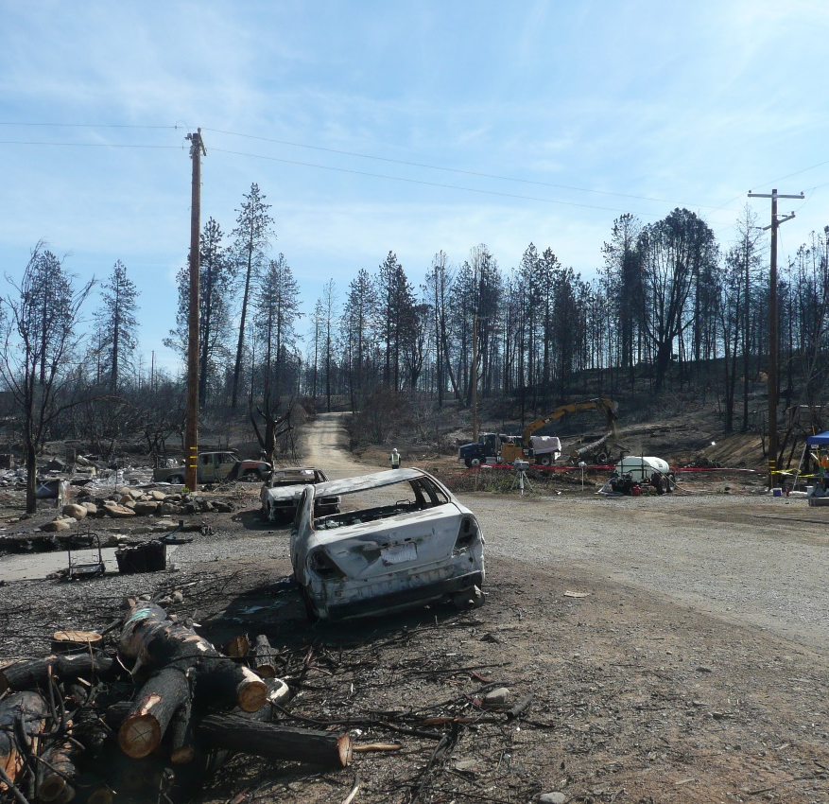
NIOSH HHE Request
Request from
Government agency in California
Operating engineers local 3
Construction and general laborer’s local 185
Management from three of most frequently contracted construction companies used for fire debris clean-up
Concerned about construction workers occupational exposures during wildland fire debris cleanup
Photo by NIOSH.

Slide 13
NIOSH HHE Request
Work activities
Cleanup of structural debris, burn ash, and hazardous materials left behind after wildfires burned homes and businesses
Exposures of concern
Respirable crystalline silica (respirable particles have diameters of 10 micrometers or less)
Asbestos
Heavy metals
Polyaromatic hydrocarbons (PAHs)
Notes:
Remnants of burned building materials and contents
Respirable crystalline silica from concrete, walls, roofing tiles, naturally occurring in rocks or soils
Asbestos (depending on age of building)
Metals (lead, cadmium, chromium, copper, iron, manganese, nickel, silver, zinc, aluminum, and others) from electronics, vehicles, appliances, or other building contents
PAHs from soot and burn ash
Other exposures include:
Noise and safety hazards from heavy equipment (front end loaders, excavators, and backhoes)
Remove chimney stacks, pull down standing walls, break concrete foundations, remove fallen trees, load debris and potentially contaminated soil, level lot

Slide 14
Phases of Cleanup
Phase 1
Removal of household hazardous waste (California Department of Toxic Substances Control)
Phase 2
Assess and document site including evaluation of soil samples to establish cleanup goals and removing asbestos containing materials (California Department of Resources, Recycling, and Recovery)
Phase 3
Debris removal (Contractors and subcontractors)

Slide 15
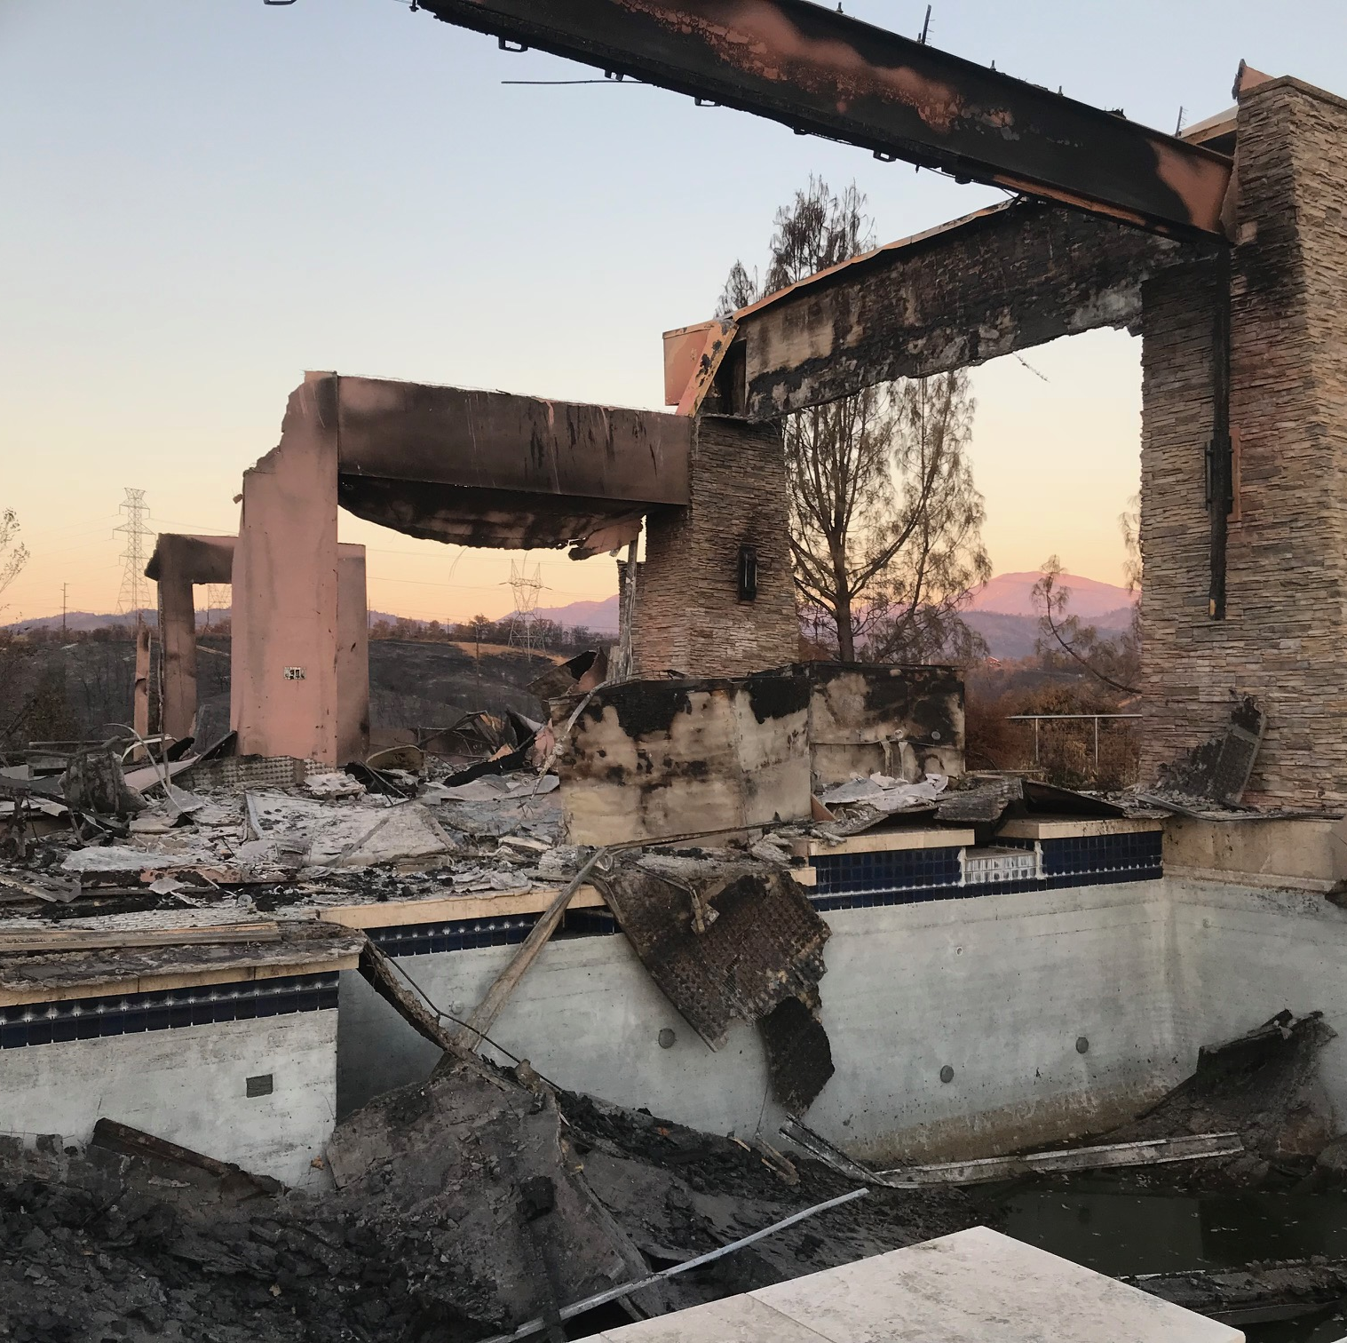
Background: California Wildfire Debris Cleanup
Carr Fire—Shasta and Trinity County California
6th most destructive in California History
229,651 acres burned
1,079 residences destroyed
22 commercial buildings
503 outbuildings
Fully contained August 30, 2018
Hazardous materials need to be removed to protect the public and the environment
Source: https://www.fire.ca.gov/incidents/2018/7/23/carr-fire
Photo by NIOSH
Notes:
The Carr Fire was the sixth most destructive wildfire in California history burning 229,651 acres and destroying 1,079 residences, 22 commercial buildings, and 503 outbuildings before it was fully contained on August 30, 2018. Hazardous materials left behind in the fire debris should be removed in a safe manner to protect the cleanup workers, general public, and the environment before rebuilding can occur. Debris cleanup is typically done by construction crews consisting of operators and laborers.

Slide 16
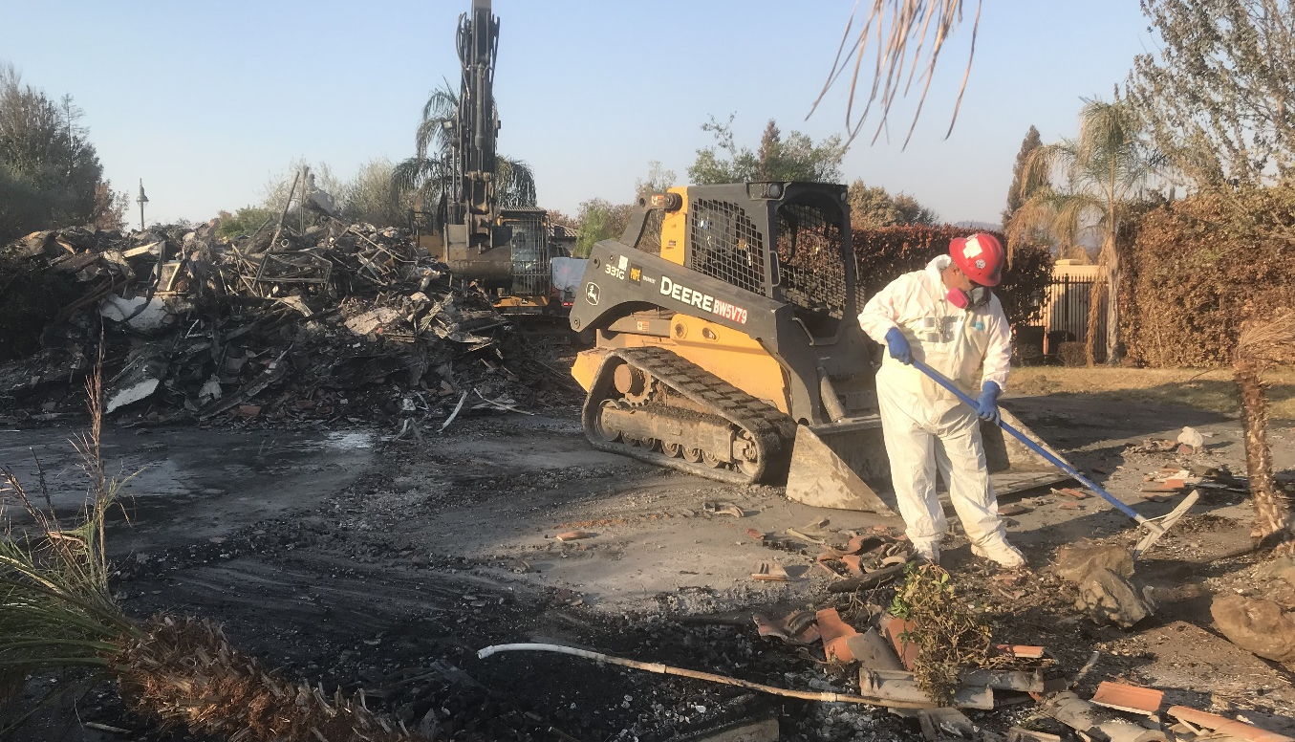
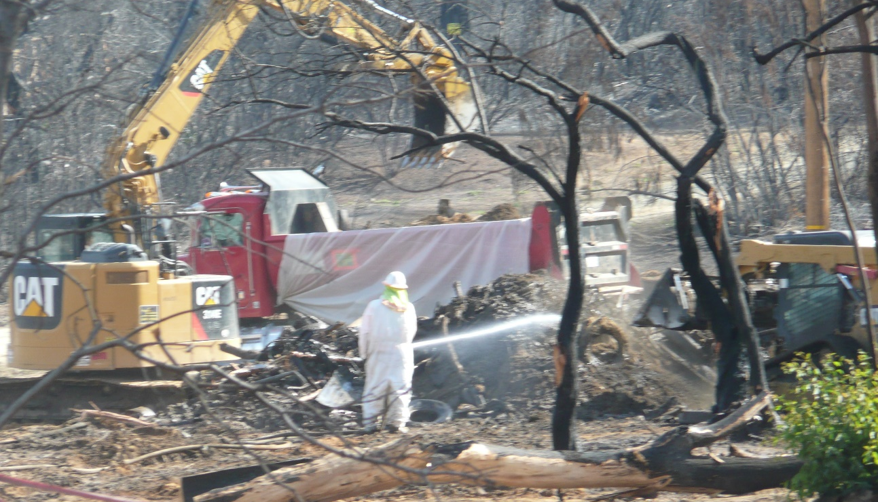
Manual Labor Tasks at Cleanup Site
Remove debris (some operate skid steers)
Dust suppression using water sprays
Cover loaded debris trucks with a tarp before departure to disposal site
Remove metal screws and nails after completion of the debris cleanup

Slide 17
Personal Protective Equipment
Required during work on lot
Tyvek® suits
Boots or boot covers
Gloves (work gloves and/or nitrile)
Respirators
Hearing protection (sometimes)
Donned before passing through decontamination area at front of lot
Doffed during exit process through the decontamination area
Notes:
Steps in decon - They first removed their boot covers (if they had them on) or walked through a boot wash. Afterwards, they remove their Tyvek suits and disposed of them in the trash can. Next, employees removed their respirators, and then removed their tight-fitting chemical resistant gloves last. The site supervisor and/or an environmental sampling technician typically remained at the table in the decontamination tent.

Slide 18
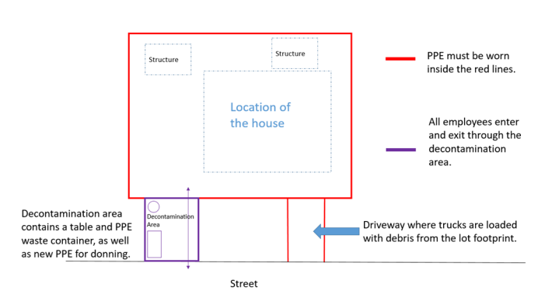
What did we do?
Evaluated exposure to RCS, asbestos, metals, and PAHs in air
Evaluated exposure to metals and PAHs on the skin
Evaluated representative task forces consisting of one task force lead, one equipment operator, and two laborers
Taskforce operated by “lots” which took ~ 3 days to clear
Notes:
Our objective was to evaluate fire debris cleanup employees’ exposure to RCS and asbestos in air, and metals and PAH in air and on the skin.
Full Shift personal air samples
Respirable crystalline silica (RCS) including quartz, cristobalite, tridymite
Asbestos fibers
Metals
PAHs
Skin wipe samples
Metals
Handwipes collected pre-shift, lunch break, post-shift
After handwashing (if done by employee)
PAHs
Hand and back of neck wipes collected pre-shift and post-shift (day one)
Hand wipes collected post-shift (day two)

Slide 19
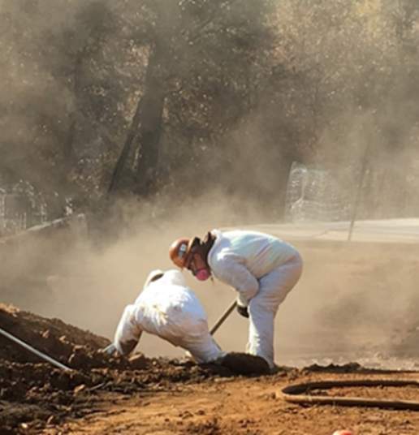
What did we find?
RCS
We detected RCS in 73% of the samples
Mean air concentration was 13.2 µg/m³ (Range 2.4 to 76 µg/m³)
2 of the 7 skid steer operators had airborne exposures above the OSHA Action Level of 25 µg/m³
One of the 7 was also above the OSHA PEL and NIOSH REL of 50 µg/m³
Asbestos Fibers
All air samples were below the applicable OELs (0.01 f/cc)
Likely due to asbestos abatement of destroyed homes prior to debris cleanup
µg/m³ = micrograms per cubic centimeter; f/cc = fibers per cubic centimeter; PEL = Permissible Exposure Limit;
REL = Recommended Exposure Limit
Notes:
Of the seven skid steer operators sampled, two had air RCS concentrations above the American Conference of Governmental Industrial Hygienists (ACGIH) threshold limit value (TLV) and OSHA action level (AL) of 25 µg/m³. One of these two was also exposed above the NIOSH recommended exposure limit (REL) and OSHA permissible exposure limit (PEL) of 50 µg/m³ [OSHA 2019a].
During fire debris cleanup, the skid steers generated substantial visible dust clouds while moving debris into piles for removal by excavators. The skid steers were equipped with rollover cages; however, these cages were not enclosed, leaving the operator exposed to dust. We found the highest exposure on the first day of fire debris cleanup. It is likely that more dust is generated on the first day and then decreases as the burnt debris is removed.
We observed that the other skid steer operator who was overexposed to RCS worked on a lot where dust suppression methods did not fully cover the worksite. This likely contributed to more dust being generated. Other factors that could influence RCS exposures include wind speed and direction and silica concentration in dust. In contrast to skid steer operators, we found that excavator operators and laborers were not overexposed to RCS. Excavator operators were enclosed in cabs, which limited their exposures, even though substantial dust was generated by the excavators.
Laborer RCS exposures were likely mitigated by the type of work (i.e., hand picking debris and holding the water suppression hose) and by the distance maintained from the skid steers and excavators.

Slide 20
What did we find?
Photo by NIOSH
Metals
No air samples for metals exceeded applicable OELs
We found metals on employees’ hands at lunch and just before leaving the worksite
PAHs
We detected some PAHs in air; all were below applicable OELs
We detected some PAHs on skin wipes
Sun/light exposure could have degraded the PAHs in ash
Photo of collecting hand wipe samples for heavy metals
Notes:
We detected metals on the hands of employees before the shift started, prior to lunch, and prior to going home at the end of their shift. This is a concern because of the potential for hand-to-mouth transfer of metals such as lead that can readily be absorbed into the body after ingestion. The presence of metals on hands before the start of the shift could indicate that soap and water alone are not effective in completely removing these metals, which is consistent with NIOSH research [Esswein et al. 2011]. Our interviews revealed the need for more frequent handwashing.

Slide 21
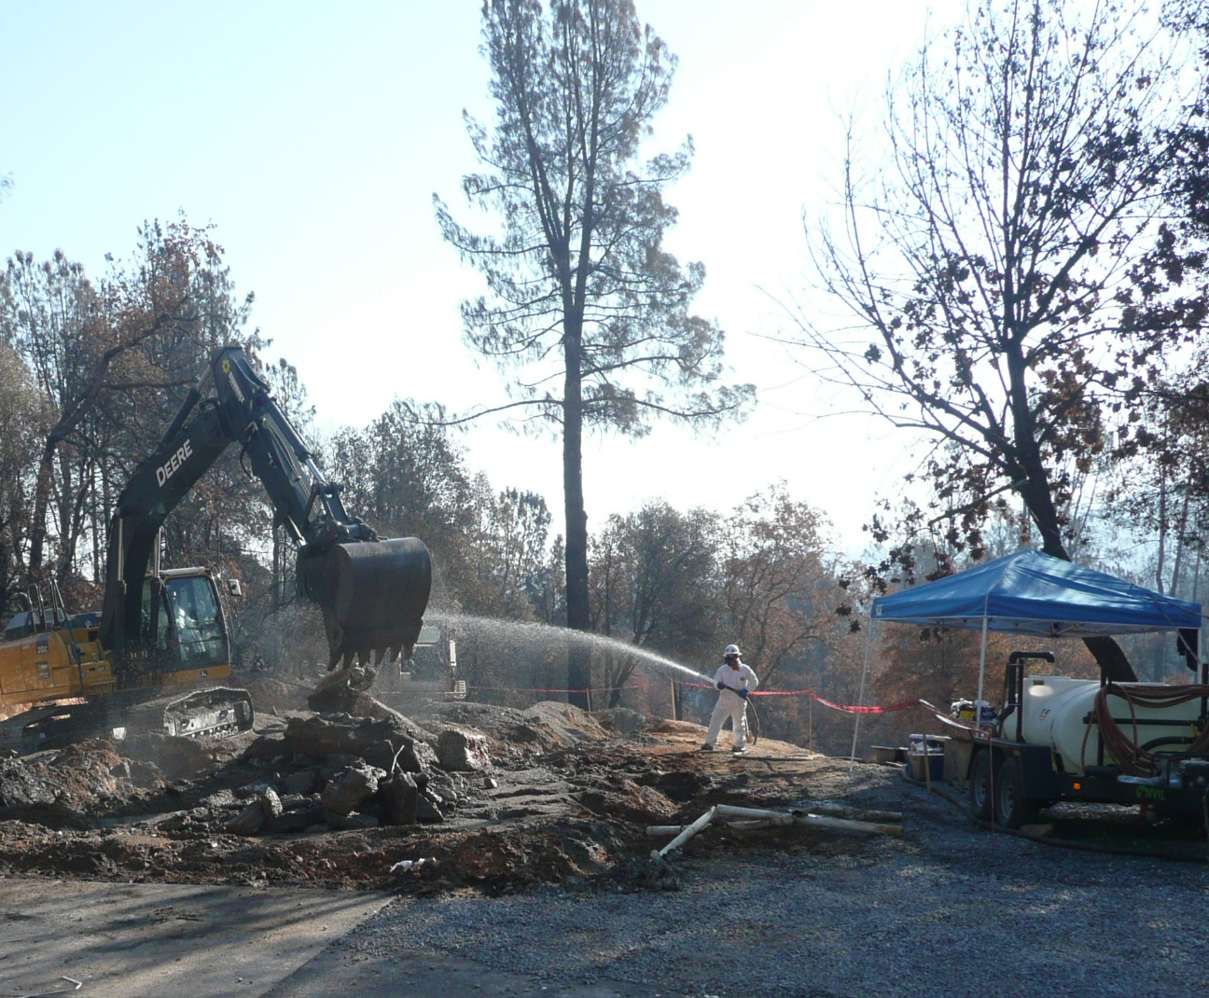
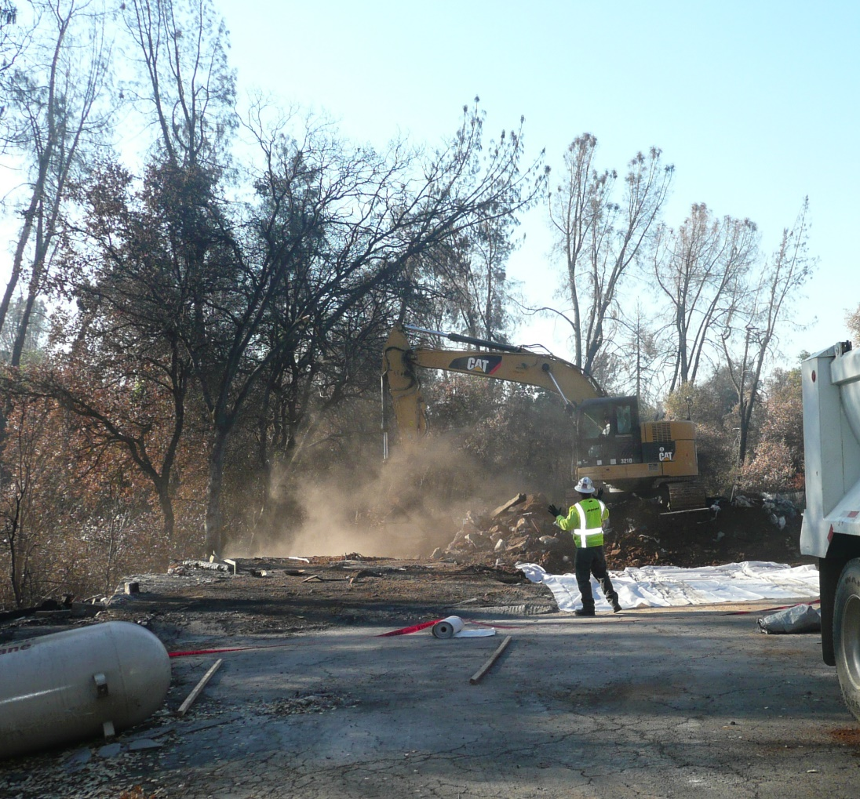
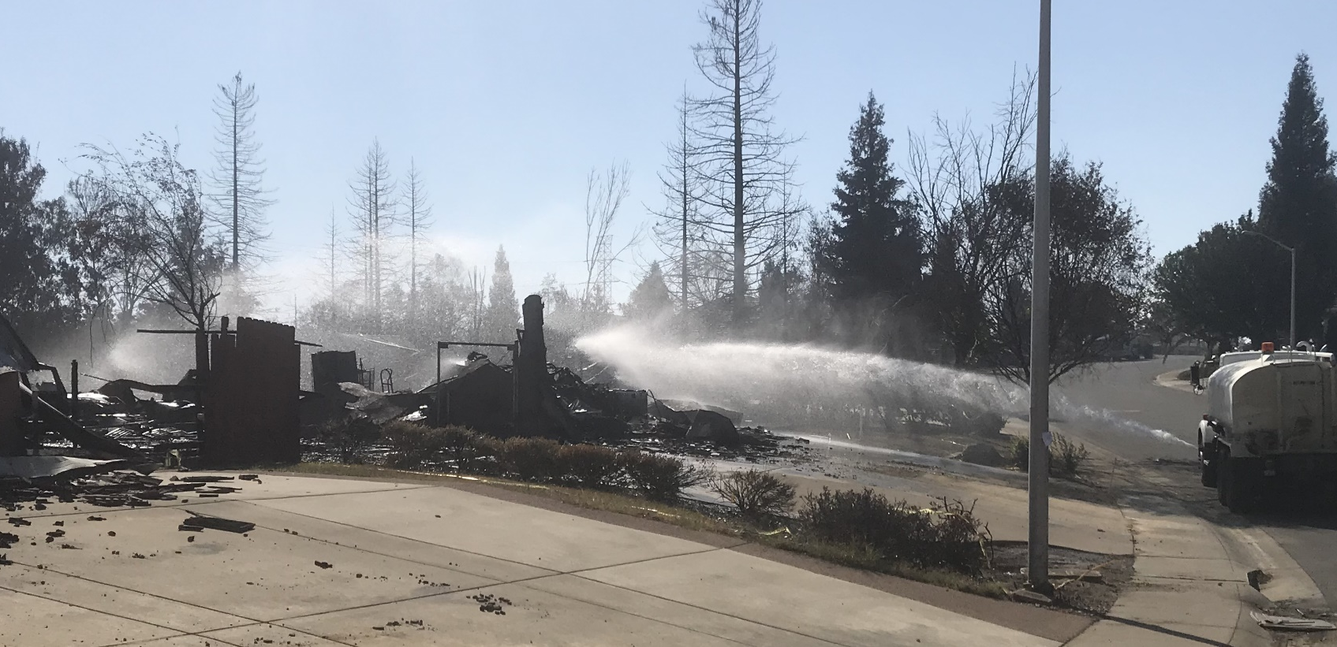
Observations
Excavator and skid steer generated large dust clouds
Manual suppression using handheld hose
Water buffalo tank holding 100 gallosn of water transported on a small trailer
Suppression from large tanker trucks full of water
Directionally sprayed to wet lots throughout the neighborhood
Airborne dust particularly visible when dust suppression methods were not in use
Notes:
Excavator and skid steer generated fairly large dust clouds
Especially when felling chimneys (excavator), breaking concrete (excavator), and piling up debris (skid steer)
One of the primary activities done by laborers was dust suppression using a handheld hose attached to a “water buffalo,” which is a tank holding about 100 gallons of water that could be transported from lot to lot on the back of a small trailer.
Homeowners or construction companies independently working on nearby lots did not always follow safety procedures or use water suppression
In some neighborhoods, we observed a large tanker truck full of water. This truck drove through the neighborhood and wet all of the damaged structures throughout the area using a large hose with a directional spray attachment. This was to ensure that all lots were wet for dust suppression even if they were not being worked on. This tanker truck was also used when felling a chimney near the back of the lot footprint. The laborer’s handheld spray could not reach the top of the chimney, so they would not fell the chimney until dust suppression was made available.
Airborne dust particularly visible
When the dust suppression methods were not in use
When water spray was not able to reach work areas where activities generated dust

Slide 22
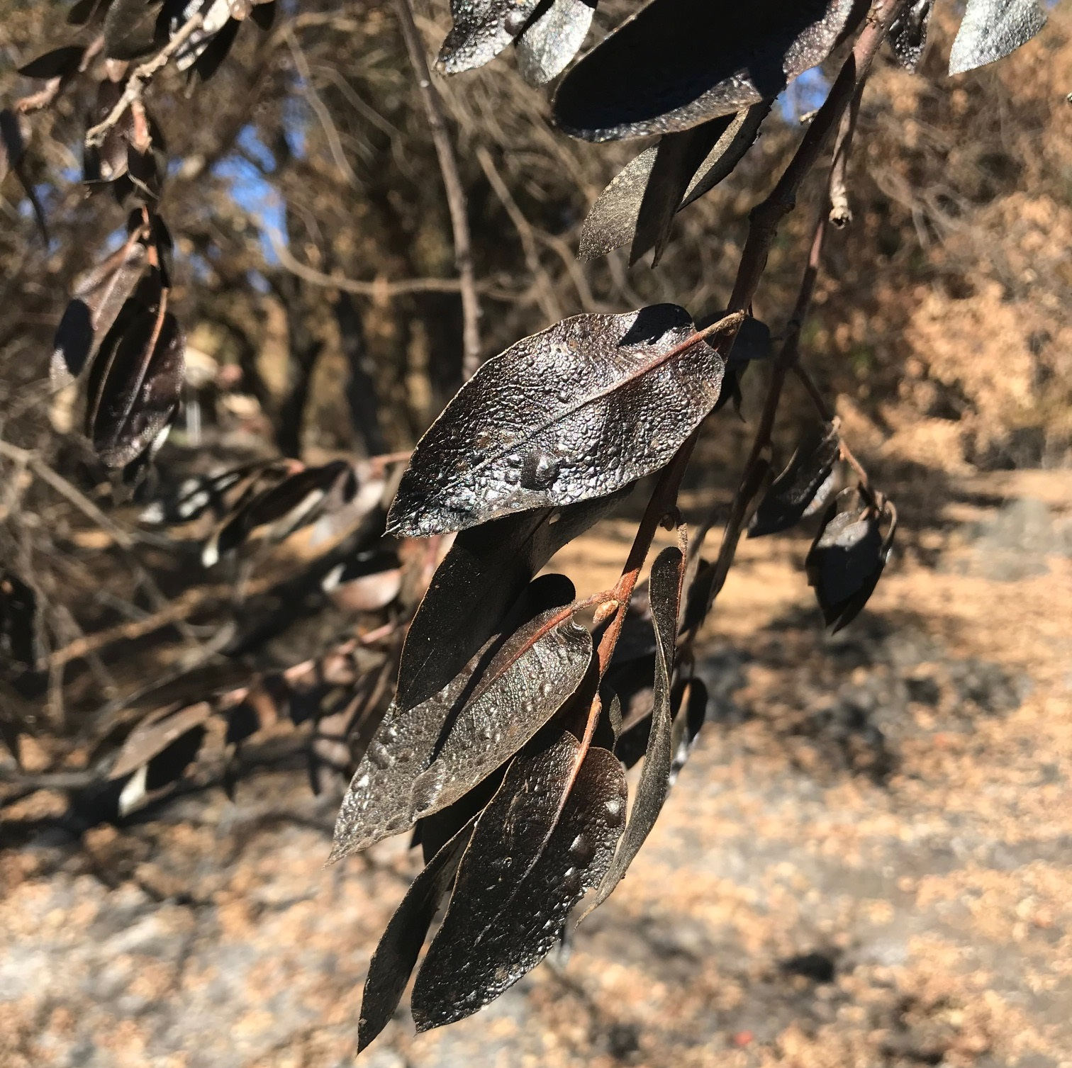
Special Considerations
California has a very clearly described process for debris cleanup and returning the lots to the homeowners
Other states might not have this
The “skid-steer” operators were more exposed than the closed-cab excavators because they did not have to in-cab filtration
Not all excavators have in-cab filtration
Utilizing wet methods during dusty operations like sawing helped to reduce exposures
In some neighborhoods a spray truck could dampen the rubble which helped to reduce exposures
Photo by NIOSH

Slide 23












Recommendations
Reduce employees’ exposures to respirable crystalline silica and educate employees on silica and silicosis
Develop a medical monitoring program
Reduce the amount of lead and other metals on the employees’ hands and work clothes
Require consistent use and enforcement of personal protective equipment and decontamination procedures among all contractors and subcontractors
Ensure all employees who are exposed to hazardous levels of noise are properly protected
Notes:
Ensure water spray is consistently used
Improve silica education
Develop a medical monitoring program
Add handwashing facilities and lead-removal handwipes at the decontamination tent
Require employees to wash their hands after leaving the lot footprint and before eating and drinking or smoking
Require employees to change shoes prior to going home to avoid tracking dust containing lead and other heavy metals home
Provide only nitrile gloves to employees
Ensure methods used to decontaminate footwear on exiting the lot are adequate and followed
Ensure all task forces comply with the respiratory protection standard
Ensure all employees who are exposed to hazardous levels of noise are protected.

Slide 24

Questions?

Slide 25
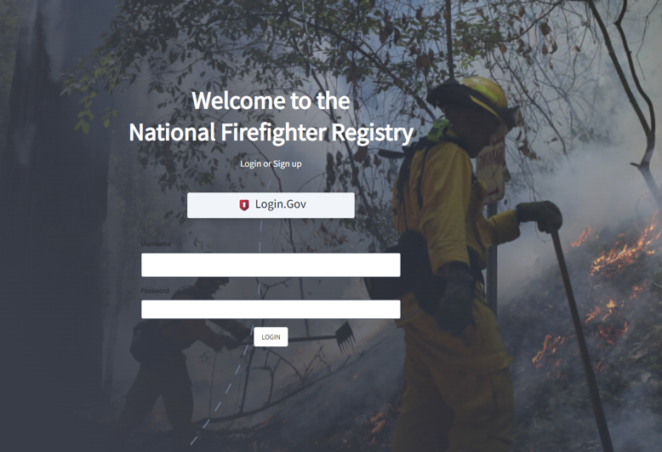
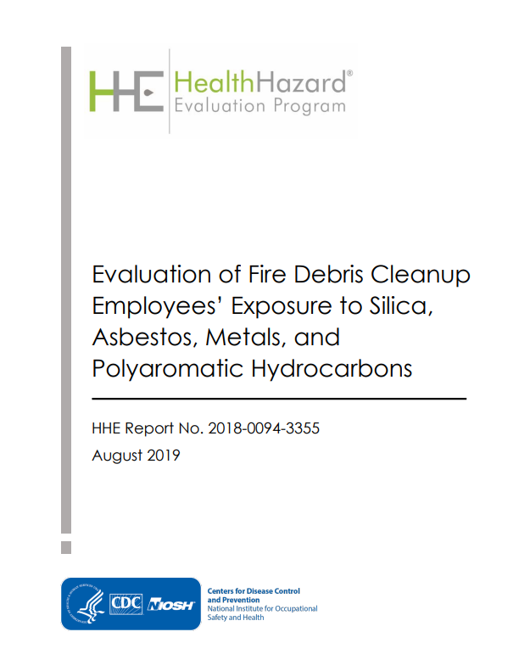

Contact information:
Catherine Beaucham
htn9@cdc.gov
(513) 841-4259
https://www.cdc.gov/niosh/hhe/reports/pdfs/2018-0094-3355.pdf
Notes:
Please let me know if you have any questions, now, or you can contact me at any time. Thank you!

